Slide 1

Comparative Analysis of Big 4 Firms Comprehensive Analysis and Insights By: Samia Belmadani, Tiffany Lagarde, Olivier Larochelle, Julien Palummo

Slide 2
TABLE OF CONTENTS
01
04
02
05
03
06
Project Overview
Dominant Topics in Reviews
Problem statement and impact of our analysis
Exploration of distinct patterns in feedback across firms using LDA topic modeling
Data Selection
Personalized Recommendation
Initial pre-processing
System recommendation using cosine similarity for employee perspective
Sentiment Analysis
Project Impact
General insights and company perspective
Significance of the project’s analyses

Slide 3
Problem Statement
Lack of Differentiation
The Big 4 firms often appear indistinguishable to job seekers due to similarities in reputation and services offered.
Complex Decision-Making
Professionals and students exploring career opportunities face challenges in discerning the unique attributes of each firm.
Need for Clarity
There is a growing demand for comprehensive analyses that provide clarity amidst the complexities of the Big 4 landscape to inform individuals' career decisions.
Importance of Employee Satisfaction
Understanding employee ratings, company culture, and benefits is crucial for enhancing satisfaction, productivity, and attracting top talent within these organizations.

Slide 4
Importance of Analysis
Strategic Decision-Making:
Comprehensive analysis of the Big 4 firms is essential for guiding strategic decisions within these organizations, including improving employee satisfaction, fostering better company culture, and attracting top talent.
Enhanced Productivity:
Optimizing employee satisfaction through insightful analyses can lead to increased productivity and reduced turnover costs, contributing to the economic success of the firms.
Transparency and Equity:
By shedding light on employee ratings, culture, and benefits, the analysis promotes transparent and equitable workplaces, aligning with societal expectations for fair treatment and diversity.
Informed Career Decisions:
Providing clarity and guidance in navigating careers within the competitive Big 4 landscape empowers individuals with insights for informed career decisions, ultimately contributing to their professional development and success.

Slide 5
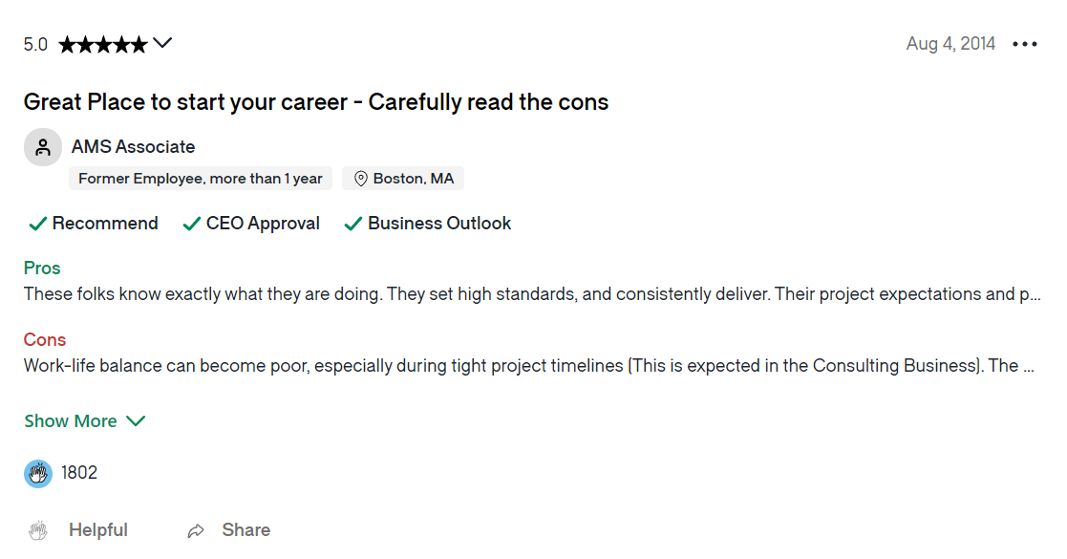
Data source
Senior Management
Firm Name
Work Life Balance
Work Life Balance
Culture Values
Diversity Inclusion
Career opportunity
Compensation & Benefits
Senior Management
Job Title
Culture Values
Utilized Data Columns
Overall Rating
Diversity Inclusion
Headline
Career Opportunity
Cons
Pros
Company Benefits
Glassdoor Review Dataset
Notes:
This is the general structure of a review:
- First have the headline comment
- Then the pros and cons
- A general rating and a rating specific to these 6 categories
This are the columns we used in our analysis

Slide 6
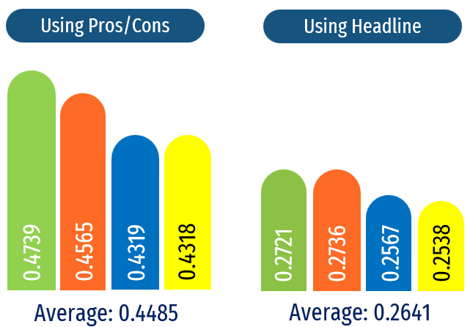
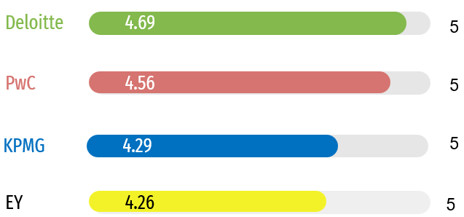
Sentiment Analysis Using Vader
Overview:
Lower sentiment score using Headline comments (overall feedback) than pros and cons comments
Employees tend to have a more pessimist tone when writing general comments than when they state the pros and cons separately
Average Overall Rating by company
Deloitte
KPMG
PwC
EY
Notes:
First analysis we did was on sentiment using analysis.
One thing we wanted to see here if there was a difference between the sentiment using a combination of pros and cons and using the headline comment
We noticed that overall the general sentiment was somewhat positive but that the one using pros and cons was higher than the one using headline which highlights that employees tend to emphasize more the negative aspects when writing general comments than when they state pros and cons separately.
We also computed the overall rating by company and noticed that the ranking matched our insights from the sentiment analysis with Deloitte ranking highest and EY the lowest.

Slide 7
Which factors to focus on – Company Perspective
Scores Impact on Headline Sentiment
Company Business Impact:
Companies should focus on improving their culture values and career opportunities to maximize their sentiment score and overall rating.
Category | Weight
Work Life Balance | 0.0999
Culture Values | 0.1762
Diversity Inclusion | 0.0038
Career opportunity | 0.1582
Compensation & Benefits | 0.0516
Senior Management | 0.0770
Scores Impact on Overall Rating
Category | Weight
Work Life Balance | 0.1546
Culture Values | 0.3088
Diversity & Inclusion | 0.0038
Career Opportunity | 0.2980
Compensation & benefits | 0.1667
Senior Management | 0.2045
Notes:
On this section we wanted to assess which factors companies should focus.
We built 2 regressions with the 6 specific ratings (work life balance, culture values, etc) as independent variables and headline sentiment as a dependent variable for one and overall rating for the other.
Here we noticed that culture values and career opportunities have the highest weights for both meaning that companies should focus on those in order to maximize their sentiment and overall score
The regression using overall rating as the dependent variable isn’t using text analytics but we used it to confirm the results we got from the first one.

Slide 8
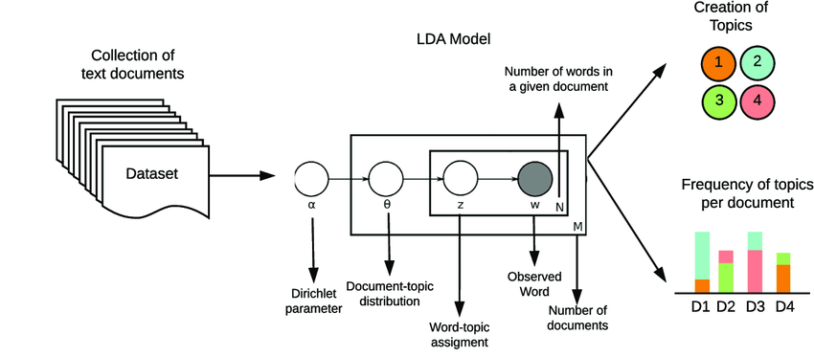
Topic Modeling with LDA
LDA is an unsupervised machine learning algorithm for topic modeling, which identifies themes within documents without predefined categories. It uncovers underlying structures by probabilistically assigning words to topics, based on the assumption that documents are composed of mixtures of topics.
Using Latent Dirichlet Allocation (LDA) topic modeling offers valuable insights for management & HR:
By automatically extracting key topics we can understand each company's unique employee concerns and strengths.
This enables, targeted action planning, and informed benchmarking recruitment and employer branding strategies.
Helps track sentiment changes over time, facilitating proactive management and improvement of employee satisfaction and company reputation.

Slide 9
Topic Modeling all Firms
Big 4’s Pros:
Reviews highlight a strong emphasis on employee well-being, with discussions centering on work-life balance, benefits, and overall quality of life.
Focus on career initiation, teamwork, and learning opportunities, indicating a positive work environment that fosters professional growth and development.
Big 4’s Cons:
Challenges associated with long working hours, workload management, and maintaining a satisfactory work-life balance.
Project-related pressures, management dynamics, and dissatisfaction with salary levels are also common themes.
Big 4s Pros | Big 4s Cons
Quality of Life | Workload
Workplace Environment | Work-Life Balance
Projects & People | Management
Learning Opportunities | Compensation
Culture | Career Development

Slide 10
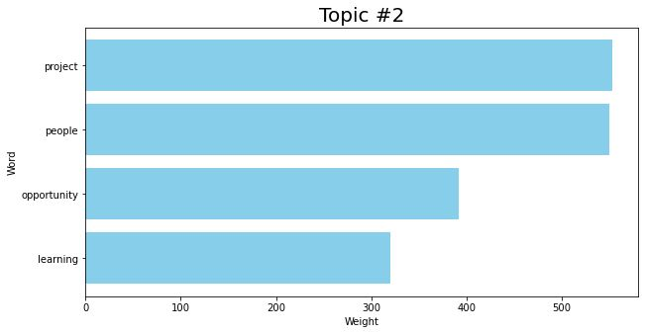
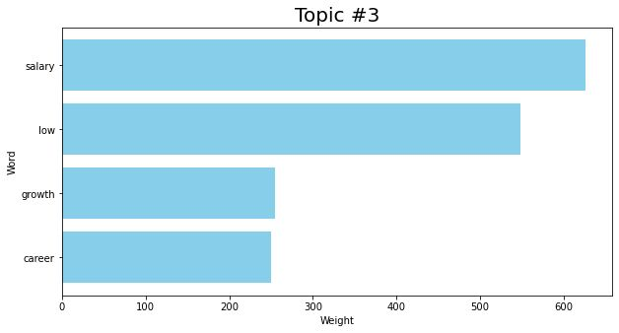
Topic Modeling all firms
Pros Topic 2: Projects & People
Cons Topic 3: Low Compensation

Slide 11
Topic Modeling for each firm
Deloitte Pros | Deloitte Cons
Work Environment | Mixed Feeling about Salary and Pay
Pay and Benefits | Desire for Growth
Learning Opportunities | Long working hours
Team Experience and People | Poor Project Management
Cultural Environment and | Impact on Work-Life Balance
PwC Pros | PwC Cons
Projects and Colleagues | Busy Season and Long Working Hours
Client Exposure & Learning Opportunities | Workload Intensity
Benefits & Pay | Poor Project Management
People and Flexibility | Lack of Collaboration and Teamwork
Growth and Organizational Culture | Low Compensation & Work-Life Balance
KPMG Pros | KPMG Cons
Company Culture and Team Dynamics | Busy Season
Opportunities for Exposure, Experience and Training | Career Progression
Clients Exposure & Learning Opportunities | Low Compensation
Growth and Development | Need to maintain Equilibrium on Work-Life Balance
Work-Life Balance | Lack Work-Life Balance
EY Pros | EY Cons
Exposure, People & Benefits | Managerial Effectiveness & Project Management
Salary, Brand & Work-Life Balance | High-working hours & Work-Life Balance
Learning through Projects | Culture & Pressure for effective Time Management
Client Interaction and Learning Opportunities | Low Pay & Demanding
Training and Workplace Atmosphere | Need for Teamwork and Collaboration
Notes:
DHEVINNNN IS THE BEST

Slide 12




Topic Modeling for each firm
Distinguish itself through its diverse project offerings and focus on exposure to clients, along with a significant emphasis on pay, salary, and career growth.
Analysis underscores concern about demanding work hours during peak seasons, workload intensity, and dissatisfaction with compensation, emphasizing teamwork as essential.
Emphasis on creating a positive work environment and fostering a friendly culture, coupled with a strong commitment to career development and learning opportunities.
Analysis showcases a negative sentiment towards salary, alongside a desire for career growth and issues related to long working hours and project management.

Slide 13


Topic Modeling for each firm
Prioritizes exposure, pay, and benefits for its employees, while also valuing brand reputation and fostering a friendly workplace atmosphere.
Findings highlight negative sentiments towards management and project management but express concerns about high working hours, workplace culture, and low pay.
Places a strong emphasis on client service excellence and a positive workplace culture, along with a focus on diverse opportunities, growth, and maintaining a healthy work-life balance.
Analysis emphasizes the intensity of work during busy seasons, a focus on career progression, concerns about compensation and work-life balance, and challenges in achieving a satisfactory equilibrium.

Slide 14
Personalized Recommendation
Objective
Approach
Rationale
Assist students or individuals seeking employment, with a specific focus on those interested in joining one of the Big 4 firms (Deloitte, KPMG, EY, and PwC), by determining the most suitable match.
Data-driven decision support with unbiased evaluation
Leverage real-world reviews from employees that work there
Interactive user experience
Time-saving approach: No need for extensive manual research
Increase the likelihood of satisfaction and success in their chosen consulting firm
Tailoring suggestions based on their specified criteria using cosine similarity

Slide 15







Personalized Recommendation – Cosine Similarity
1. Modify dataset to keep only 1000 reviews of minimum 40 characters for each of the Big 4 firms, for a total of 4000 reviews. This is done to make a fair analysis.
5. Select the top 100 reviews with the highest similarity score
2. User inputs his criteria of what he is looking for in a consulting firm
6. Find the firm with the highest frequency (most appearances) in this top 100
3. Prepare textual data for analysis (text cleaning, tokenization, lemmatization…)
7. Recommend this firm as the best fit for what the user
4. Calculate the pairwise cosine similarity between the user input and each review (pros column).
Each text segment is represented as a vector
The values in the vector are derived from the term frequency (TF)
Measure the cosine of the angle between two vectors

Slide 16
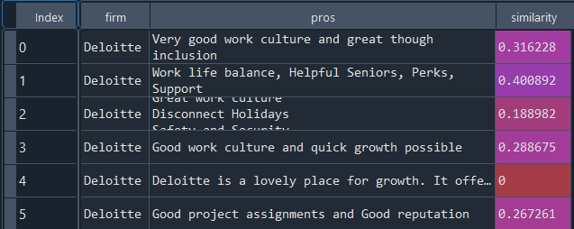
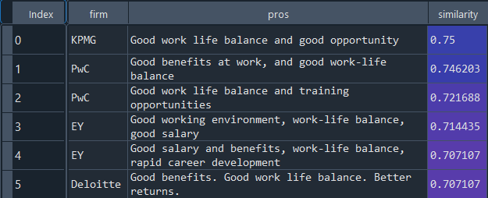
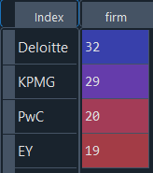
Personalized Recommendation – Example
1
Indicate the qualities you are searching for in a company:
"Good salary, work-life balance, opportunities, benefits, training”
2
3
Reorder and keep top 100
Calculate similarity scores
4
Appearances frequency
5
Based on your preferences, the company that is the best fit is Deloitte

Slide 17
Summarizing the Influence of Our Analysis on Stakeholders
Impact on Company Improvement:
Reveals areas of employee satisfaction and potential areas for improvement.
Provides insights for internal enhancement and competitive positioning within the Big 4.
Impact on Job Seekers/Young Professionals:
Our cosine similarity system assists in identifying the Big 4 firm that best aligns with their values and interests.
It addresses the challenge of unclear distinctions between firms by differentiating them based on their top topics identified through LDA analysis.

Slide 18
Thank You !

